Slide 1
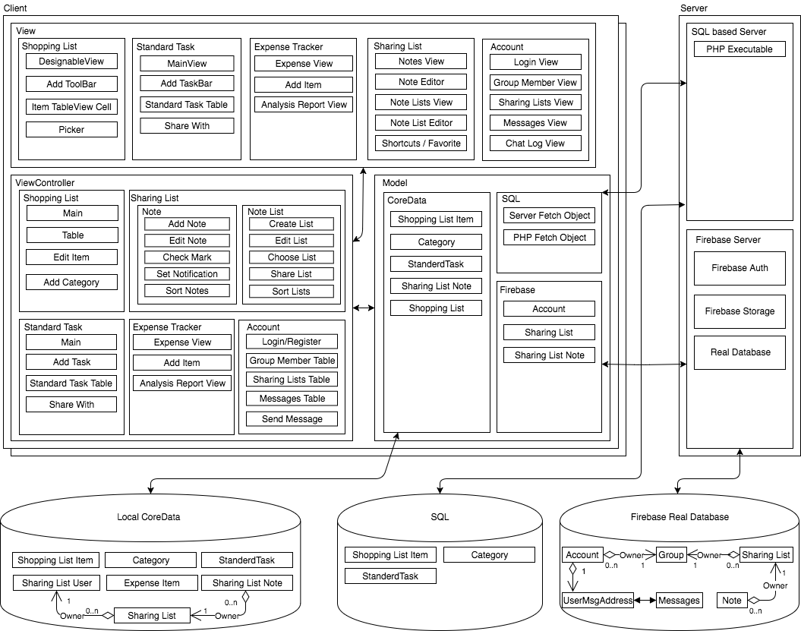
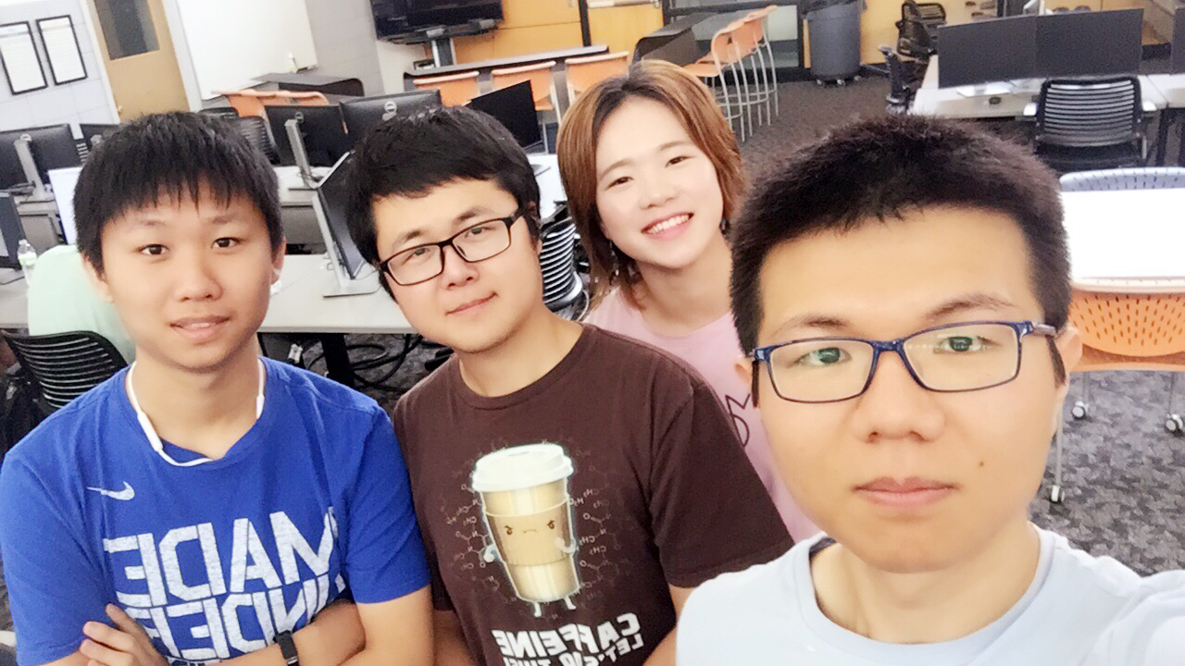
The Reminder
Com S 309 Fall 2017
Project Description:
Designed for Iowa State students to input their class schedule and the program will give them a bus schedule.
Text Directions
Visual Map Directions
Users:
Administrators
ISU Students
User Interfaces
Schedule Creator
User inputs their class schedule
Text Schedule Viewer
User views their generated schedule
Interactive Map
User can view where on the map the bus stops are located
Administration Data Editor
Allows for changes to the data used in calculating the routes
Block Diagram
Module Interfaces:
Design Decisions:
Database of bus times
Single threaded
Modulated the generator to simplify the process
Interactive Map
Yijia Huang, Zhenyu Zhao
Bei Zhao, Geng Sun
COM S 309 FALL 2017
Team Info:
BK_B_2
Yijia Huang– CPRE (Jr)
Zhenyu Zhao– CPRE (Jr)
Bei Zhao– CPRE (Jr)
Geng Sun– CPRE (Jr)
What went wrong:
What went right:
Lessons Learned:

